Slide 2
Insert Objective 1
Insert Objective 2
Insert Objective 3

Slide 3
Notes:
Key points
The changes that we are seeing in the healthcare landscape are being driven by 3 key factors (1) better quality (2) lower cost (3) and safety
The changes are affecting payments for certain outcomes, 30 day readmissions and some hospital acquired conditions
Speaker notes
Discuss the fact that healthcare is a function of quality and cost. Address the 3 areas on the slide: quality patient care, readmissions, and hospital-acquired conditions and the recent changes in those areas over the last few years in health care reform.

Slide 4
Notes:
Key points
The hospital is a huge driver of US expenditures on health care. Leading these expenditures medical events that are very costly including surgical site infections, falls, pressure ulcers and avoidable readmissions.
Speaker notes
Discuss that these costs along with an emphasis on quality are why the government has chosen to take a closer look at many of these conditions.

Slide 5
Notes:
Key points
Evolving demographics where the population is aging, life expectancy is going up and more healthcare is being consumed; there is also evolving healthcare policy where pressures exist to increase quality of care and decrease costs
This allows for a unique opportunity to elevate nutrition to improve patient outcomes
Speaker notes
Discuss that overall we, as healthcare professionals, are in the perfect storm. There are evolving demographics where the population is aging, life expectancy is going up and more healthcare is being consumed. There is also evolving healthcare policy where pressures exist to increase quality of care and decrease costs. The best part of this is that nutrition matters and can make an impact. The time is now to elevate nutrition.

Slide 6
Notes:
Key points
Malnutrition has been a problem for hospital patients for quite some time and it occurs in 30% to 50% of hospitalized patients. Malnutrition directly contributes to poor clinical outcomes in the areas of infections, pressure ulcers, readmissions and falls.
Speaker notes
This slide represents that malnutrition is one of the puzzle pieces contributing to poor clinical outcomes.

Slide 7
Notes:
Key points
Malnutrition is seen across all healthcare settings
Up to 50% of patients in the hospital and long term care setting are malnourished
Risk of malnutrition is increased in older patients, critically ill patients, etc
Speaker notes
Describe scope of the malnutrition problem in the healthcare setting. Up to 50% if patients in the hospital are malnourished, and up to 51% of patients in long-term care facilities are malnourished. Even patients in the outpatient and home health setting experience malnutrition, with 13-30% malnutrition prevalence in those patients.

Slide 8
Notes:
Key points
Malnutrition negatively impacts patients outcomes including increasing mortality, infections, complications, LOS and cost while decreasing wound healing, quality of life, and convalescence
Those factors will drive increase cost and lower quality of life
Speaker notes
This slide represents the negative impact that malnutrition has on a plethora of patient outcomes including increasing mortality, infections, complications, LOS and cost while decreasing wound healing, quality of life, and convalescence.

Slide 9
Notes:
Key points
Malnutrition negatively impacts patients outcomes including increasing LOS, mortality, infections, complications, readmissions, as discussed on the previous slide, and all these consequences lead to significant costs
Speaker notes
This slide represents the negative impact that malnutrition has on a plethora of patient outcomes including LOS, mortality, infections, complications, and cost

Slide 10
Notes:
Key points
Fortunately, ONS has shown significant clinical benefits in pressure ulcers, complications, and readmissions
Speaker notes
According to Stratton et al, intervening with ONS reduced pressure ulcer incidence by 25%. In GI surgery patients there has been a reduction of complications by 63% with nutrition intervention and in another study there were significantly fewer falls. Another recent study showed, there has been a reduction in avoidable rehospitalizations by as much as 28% with nutrition intervention.

Slide 12
Notes:
Key points
Impact of oral nutritional supplementation provided during hospitalization was studied in a new health economic analysis, the Philipson Hospital Outcomes Health Economic study
Rate of ONS use in this data set was a staggeringly low 1.6%
Speaker notes
Presenter to discuss findings. This study is a retrospective look at an 11 year database with data from the Premier hospital system – which includes diagnostic and billing data. The database included 44 million adult inpatients episodes (or hospital stay). Within that sample, ONS was used in only 725,000 episodes, which equaled a rate of ONS use of only 1.6%. Only includes if there was an order for an ONS in the chart, does not include if it was delivered or consumed and does not get at compliance.

Slide 13
Notes:
Key points
Nutrition supplementation provided during hospitalization was associated with a 21% decrease in LOS, 21.6% decrease in episode cost, and a 6.7% decrease in probability of a 30-day readmission
Speaker notes
Presenter to discuss findings. So when we compare those matched groups, we get the following results:
-21% decrease in LOS (2.3 Days)
-21.6% decrease in episode cost (which equals $4,734 dollars per episode)
-6.7% decrease in probability of 30-day readmission
In addition, ONS cost per episode was approx. $88.26, which is fully burdened (includes the ONS cost, administrative and staffing costs, etc)/ So for each $1 spent on ONS, it saves approx. $52.63.

Slide 15
Notes:
Key points
Malnutrition is a significant factor in the development of pressure ulcers
Malnourished patients have a higher likihood to develop a pressure ulcer (with an odds ratio of 3.8)
Speaker notes
In this slide, we see that malnutrition is a significant factor in the development of pressure ulcers. Fry, et al found that someone who is malnourished will have a higher likihood to develop a pressure ulcer (with an odds ratio of 3.8). This study was done in over 800,000 surgical patients looking at the association between different factors (CABG surgery, malnutrition/weight loss, etc) and various never events.

Slide 16
Notes:
Key points
This systematic review and meta-analysis was undertaken to address the impact of enteral nutritional support on pressure ulcer incidence and healing and a range of other clinically relevant outcome measures in this group
This systematic review shows enteral nutritional support, particularly high protein ONS, can significantly reduce the risk of developing pressure ulcers (by 25%). Although studies suggest ONS and ETF may improve healing of PU, further research to confirm this trend is required.
Speaker notes
Presenter to discuss study findings. Fifteen studies (including eight randomized controlled trials (RCTs)) of oral nutritional supplements (ONS) or enteral tube feeding (ETF), identified using electronic databases (including Pub Med and Cochrane) and bibliography searches, were included in the systematic review. Outcomes including pressure ulcer incidence, pressure ulcer healing, quality of life, complications, mortality, anthropometry and dietary intake were recorded, with the aim of comparing nutritional support versus routine care (e.g. usual diet and pressure ulcer care) and nutritional formulas of different composition. Of these 15 studies, 5 RCTs comparing ONS (4 RCTs) and ETF (1 RCT) with routine care could be included in a meta-analysis of pressure ulcer incidence. This systematic review shows enteral nutritional support, particularly high protein ONS, can significantly reduce the risk of developing pressure ulcers (by 25%). Although studies suggest ONS and ETF may improve healing of PU, further research to confirm this trend is required.

Slide 18
Notes:
Key points
Malnourished patients have up to 3x higher rate of infections
Speaker notes
In other data, we see that malnourished patients have up to 3x higher rate of infections. In this study by Schneider et al in 2004, we see that severely malnourished patients had a 3x higher rate of infections than well nourished patients and approximately 2x greater than patients who are moderately malnourished.

Slide 19
Notes:
Key points
Nutrition intervention can also impact complications in different patient populations
This meta-analysis showed that enteral nutrition (ONS and tube feeding) significantly reduced postoperative complications in GI surgery patients by 63%
Speaker notes
The effect of ONS and tube feeding on clinical outcome, specifically in gastrointestinal (GI) surgical patients, was addressed in a meta-analysis of 18 RCT (n=907; patients undergoing a variety of procedures, including gastrectomy, hemicolectomy, cholecystectomy, hemigastrectomy, laparotomy and resection, oesophagogastrectomy and pancreatoduodenectomy). This showed enteral nutrition (supplements, tube feeding) significantly reduced postoperative complications (wound, respiratory and other infections, postoperative ileus, wound dehiscence, respiratory complications, unresolved peritonitis with relaparotomy) with an OR of 0.37 (95% CI 0.26– 0.53). In a separate analysis, these beneficial reduction complication rates were significant both for patients receiving ONS [250–600 kcal/day for 7 days to 10 weeks, OR 0.37 (95% CI 0.23–0.60)] and those receiving tube feeding [831–2852 kcal/day for <11 days, OR 0.37
(95% CI 0.22–0.61)].

Slide 20
Notes:
Key points
The present study was undertaken to investigate the short term clinical efficacy of oral dietary supplements administered post-operatively to patients undergoing predetermined moderate to severe gastrointestinal surgery
A normal diet plus oral nutritional supplements resulted in an increase in energy intake, decreased weight loss after hospital discharge, and decreased complications as compared to the control group.
Speaker notes
Presenter to discuss study findings. Trial end points for comparison included effects of oral dietary supplements on nutritional intake, nutritional status and incidence of serious complications. 54 patients who were scheduled to undergo predetermined moderate to major gastrointestinal surgical procedures entered the study. They were randomly assigned to receive a normal ward diet post-operatively or the same diet supplemented ad libitum by an oral nutritional sip feed. 40 patients (20 in each group) completed the study. The mean daily energy intake (KCal/day) assessed from 7 day food diaries was significantly higher in the treatment group (1833 +/- SEM 99) than in the control group (1108 +/- 56, p < 0.0001). This increase occurred not only as a consequence of energy intake from the oral dietary supplements (470 +/- 30) but also because more energy was consumed from the ward diet by the treatment than the control patients (1353 +/- 92 vs. 1108 +/- 56, p < 0.02). The mean daily protein intake g/day in the treatment group (66.0 +/- 3.4) was also greater than in the control group (52.9 +/- 29 p < 0.0001). This difference was due solely to the intake in protein from the oral dietary supplements (15.7 +/- 1.0), protein intake from the ward diet being similar in the treatment (50.1 +/- 3.2) and control (52.9 +/- 29) groups. Patients in the treatment group maintained their pre-operative weight where as control patients had lost significant amount of their pre-operative weight by study day 3 (4.5 +/- 12 kg and by discharge (4.7 +/- 1.2 kg, p < 0.02). Pre-operative muscle function as evidenced by grip strength dynamometry decreased to a greater extent in the control than treatment group patients by study day 3 (14.6 +/- 2.2 KPa vs. 2.8 +/- 2.4 < 0.03) and by discharge (10.4 +/- 3.1 KPa vs. 0.10 +/- 1.9 p < 0.03). The incidence of serious infections (pneumonia, wound infection) was significantly higher in the control group (10) than in the treatment group (3, p < 0.02). It is concluded that the prescription of oral dietary supplements on an ad libitum basis to post-operative patients undergoing moderate to major gastrointestinal surgery results in clinically significant short term benefits.

Slide 21
Notes:
Key points
This study was done to show that structured lipid supplemented peptide-based enteral formula decreased infectious complications and length of stay in cardiac surgery patients
Speaker notes
Presenter to discuss study findings. This study was a prospective trial with historical control. Patients in prospective group received immune-modulating enteral formulation fortified with fish oil/MCT structured lipid and scFOS. Historical control group received standard enteral formula. The objective of the study was to evaluate the impact of an immune-modulating enteral formula on infection rates in patients following cardiac surgery. Significantly fewer patients who received immune-modulating formula had any infectious complication (18% vs. 26%, P≤0.048). Furthermore, patients who received IMD had a significantly shorter stay in the ICU (27 vs. 31 days, P=0.002). No differences were observed between the control group and immune-modulating group for the percentage of patients who had sepsis or a C. diff positive culture.

Slide 23
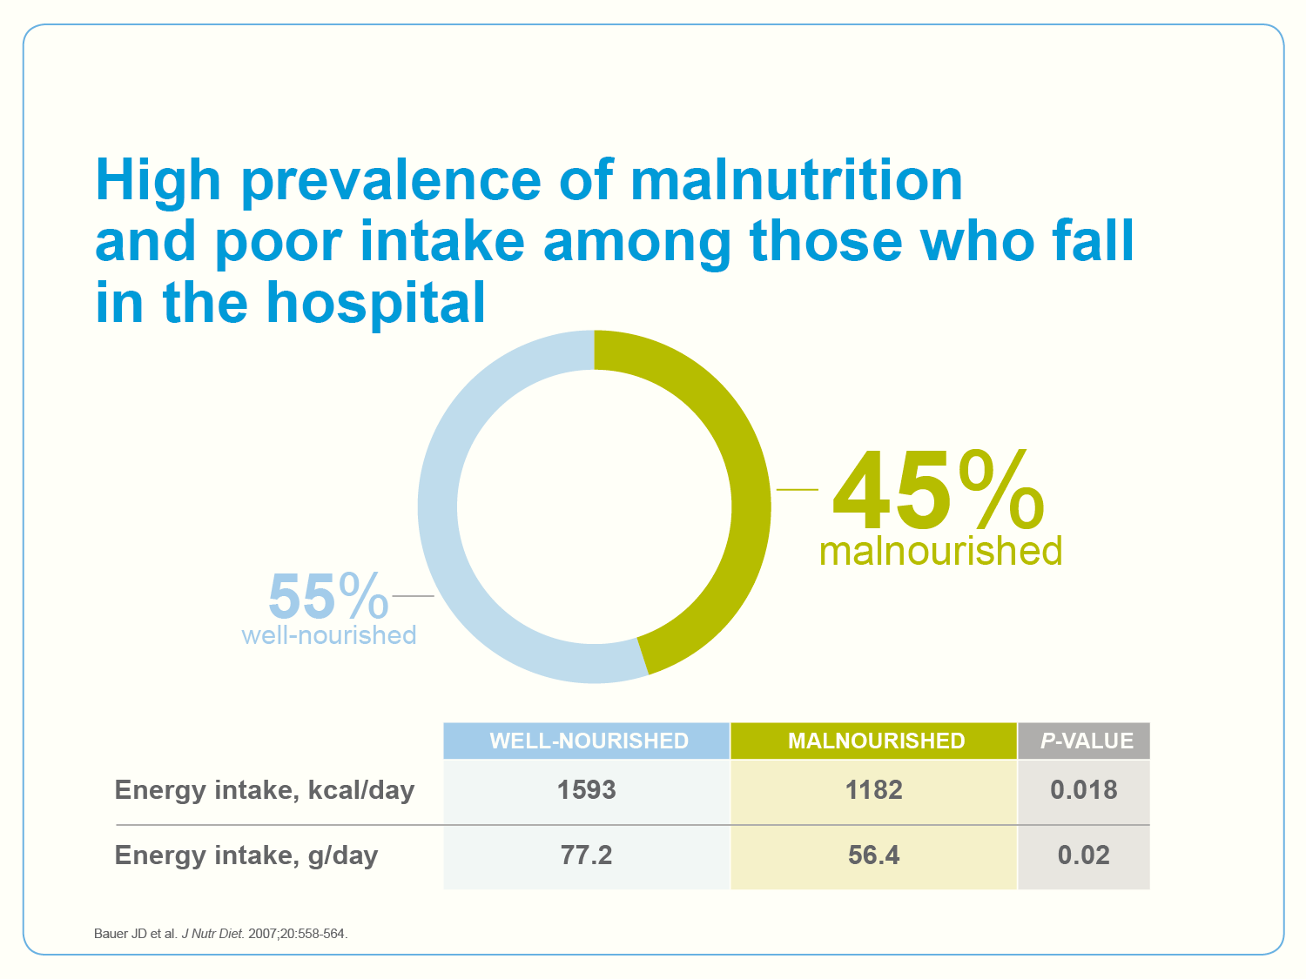
Notes:
Key points
This study was done to show that there is a high prevalence of malnutrition and poor food intake among those who fall in the hospital.
Speaker notes
Presenter to discuss study findings. Forty-nine patients who had experienced a fall while admitted at an Australian private hospital participated in the study (age: 71.2 (SD 14.1) years; 21 male: 28 female). Nutritional status was assessed using subjective global assessment. Protein and energy intake was determined by dietary history and analyzed using Australian computerized food composition data. According to subjective global assessment, 27 patients were well nourished and 22 malnourished (21 moderately, one severely malnourished). Well nourished fallers had significantly higher BMI (mean difference 3.7 kg/m2, CI: 1.2-6.2), dietary protein (mean difference 19.8 g, CI: 2.0-37.5) and energy intake (mean difference 1751 kJ, CI: 332-3170) compared to malnourished fallers. There was no difference in severity of falls based on nutritional status, weight or BMI. There was a high prevalence of malnutrition and poor intake in this sample of patients who had fallen in hospital. Nutrition assessment and intervention for patients who have fallen in the acute care setting should be considered.

Slide 24
Notes:
Key points
This study was done to show that ONS led to fewer falls among frail elderly in the community.
Speaker notes
Presenter to discuss study findings. This study was a randomized controlled trial that was conducted to assess the impact of nutritional supplementation on the functional status of frail elderly living at home. Subjects (n = 50) over age 60 (mean 78 y) requiring community services and at elevated risk of undernutrition (excessive weight loss or body mass index <24 kg/m2) were randomized to a high energy nutrient dense supplement provided by a dietitian or a control group receiving visits only. Outcome measures, including changes in handgrip strength, general well-being score, perception of health and number of falls, were measured by an investigator who was unaware of treatment assignment. After 12 wk, weight gain was greater in the supplemented group (2.1±2.3 vs. 0.6±1.6 kg; P < 0.01). Despite adequate statistical power, no functional measures differed except that the number of falls was lower among treated subjects vs. controls (0% vs. 21%; P = 0.05). Frail elderly can gain weight through oral supplementation, indicating the reversibility of weight loss in this group, but changes in functional status indicators may require a longer period of supplementation.

Slide 25
Notes:
Key points
This study was done to show that nutrition intervention in older adults led to fewer falls.
Speaker notes
Presenter to discuss study findings. This study was a randomized controlled trial to evaluate the effects of a short-term nutritional intervention with protein and vitamin D on falls in malnourished older adults from hospital admission until 3 months after discharge. Participants were randomized to receive nutritional intervention (energy- and protein enriched diet, oral nutritional supplements, calcium, vitamin D supplement, telephone counseling by a dietitian) for 3 months after discharge or usual care (n=210). Three months after discharge, 10 participants
(10%) in the intervention group had fallen at least once, compared with 24 (23%) in the control group (hazard ratio = 0.41, 95% confidence interval (CI) = 0.19–0.86). There were 57 fall incidents (16 in the intervention group; 41 in the control group). A significantly higher intake of
energy (280 kcal, 95% CI = 37–524 kcal) and protein (11 g, 95% CI = 1–25 g) and significantly higher serum 25-hydroxyvitamin D levels (10.9 nmol/L, 95% CI = 2.9–18.9 nmol/L) were found in participants in the intervention group than in controls. A short-term nutritional intervention consisting of oral nutritional supplements and calcium and vitamin D supplementation and supported by dietetic counseling in malnourished older adults decreases the number of patients who fall and fall incidents.

Slide 27
Notes:
Key points
Risk for readmissions is associated with poor nutritional status and weight loss.
Speaker notes
All the factors listed on the slide, including frailty, disability, weight loss, and certain chronic conditions are associated with an increased risk of hospital readmissions, and are also associated with poor nutritional status, highlighting the connection between nutrition and readmissions.

Slide 28
Notes:
Key points
Nutrition intervention reduces hospital readmissions
Speaker notes
Presenter to discuss that recently, 2 large RCTs have highlighted significant reductions in hospital readmissions following the use of ONS initiated in the hospital and continuing post-discharge in individuals with GI disease and acutely ill hospital patients (ref 3 and 4 on chart). Other trials have shown lower, although not statistically significant, hospital admissions/readmissions with the use of ONS vs. routine care. When these studies were combined in a meta-analysis, the results highlight a statistically significant reduction in hospital admissions with ONS (Odd ratio OR = 0.56 (95% Confidence Interval CI = 0.41.0.77, of 6 RCTs). This OR means that there is a 44% reduction in the risk of readmission to the hospital. The cost savings associated with such reduction in health care use are important, and associated improvements to the patient’s quality of life are also important for patient satisfaction.

Slide 29
Notes:
Key points
Nutrition intervention reduces hospital readmissions.
Speaker notes
Presenter to discuss study findings. This study was a randomized controlled trial to evaluate whether nutritional support of older patients during acute illness leads to a clinical benefit. The study randomly assigned 445 hospitalized patients aged 65 to 92 years to receive either a normal hospital diet plus 400 mL oral nutritional supplements (223 subjects) or a normal hospital diet plus a placebo (222 subjects) daily for 6 weeks. The composition of the supplement was such as to provide 995 kcal of energy and 100% of the Reference Nutrient Intakes for vitamins and minerals for a healthy older person. Patients had three assessments: at baseline, at 6 weeks, and at 6 months post-randomization. Outcome measures were 6 months of disability, non-elective readmission and length of hospital stay, discharge destination, morbidity, and mortality. Randomization to the supplement group led to a significant improvement in nutritional status. Over 6 months, 65 patients (29%) in the supplements group were readmitted to the hospital compared with 89 patients (40%) in the placebo group (adjusted hazard ratio 0.68 [95% confidence interval 0.49 0.94]). The mean length of hospital stay was 9.4 days in the supplements group compared with 10.1 days in the placebo group. Thirty-two people (14%) died in the supplement group compared with 19 people (9%) in the placebo group at 6 months (adjusted hazard ratio 1.65 [95% confidence interval, 0.93-2.92]). Oral nutritional supplementation of acutely ill patients improved nutritional status and led to a statistically significant reduction in the number of non-elective readmissions.

Slide 30
Notes:
Key points
High protein ONS result in clinical, nutritional and functional benefits
Speaker notes
Presenter to discuss findings. Disease-related malnutrition is common, detrimentally affecting the patient and healthcare economy. Although use of high protein oral nutritional supplements (ONS) has been recommended to counteract the catabolic effects of disease and to facilitate recovery from illness, there is a lack of systematically obtained evidence to support these recommendations. This systematic review involving 36 randomized controlled trials (RCT) (n = 3790) (mean age 74 years; 83% of trials in patients >65 years) and a series of meta-analyses of high protein ONS (>20% energy from protein) demonstrated a range of effects across settings and patient groups in favor of the high protein ONS group. These included reduced complications (odds ratio (OR) 0.68 (95%CI 0.55–0.83), p < 0.001, 10 RCT, n = 1830); reduced readmissions to hospital (OR 0.59 (95%CI 0.41–0.84), p = 0.004, 2 RCT, n = 546); improved grip strength (1.76 kg (95%CI 0.36–3.17), p < 0.014, 4 RCT, n = 219); increased intake of protein (p < 0.001) and energy (p < 0.001) with little reduction in normal food intake and improvements in weight (p < 0.001). There was inadequate information to compare standard ONS (<20% energy from protein) with high protein ONS (>20% energy from protein). The systematic review and meta-analysis provides evidence that high protein supplements produce clinical benefits, with economic implications.

Slide 31
Notes:
Key points
High protein ONS result in clinical, nutritional and functional benefits
Speaker notes
Presenter to discuss study findings. In a review of 36 RCTs and 3,790 subjects (mean age 74 years; 83% of trials in patients >65 years) with high protein - ONS resulted in clinical, nutritional, and functional benefits including a reduction in complications, length of stay, and hospital readmissions. Presenter to describe percentage reductions.

Slide 32
Insert Summary 1
Insert Summary 2
Insert Summary 3
Notes:
Insert your summary or call to action here

